Slide 1

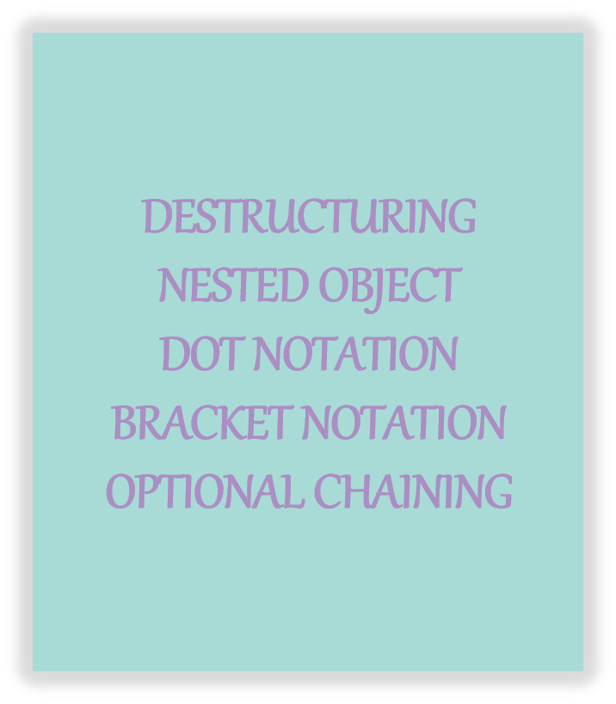
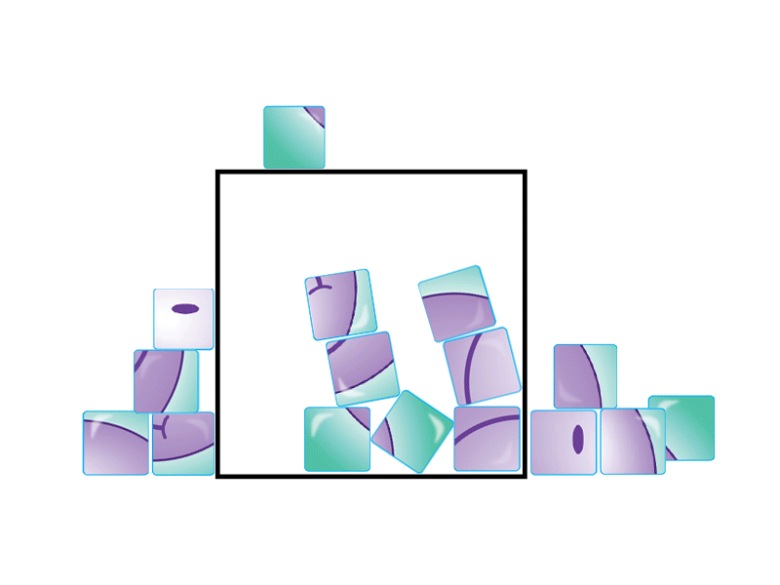
DESTRUCTURING
NESTED OBJECT
DOT NOTATION
BRACKET NOTATION
OPTIONAL CHAINING

Slide 2


Destructuring
in
JavaScript

Slide 3


What is destructuring?

Slide 4
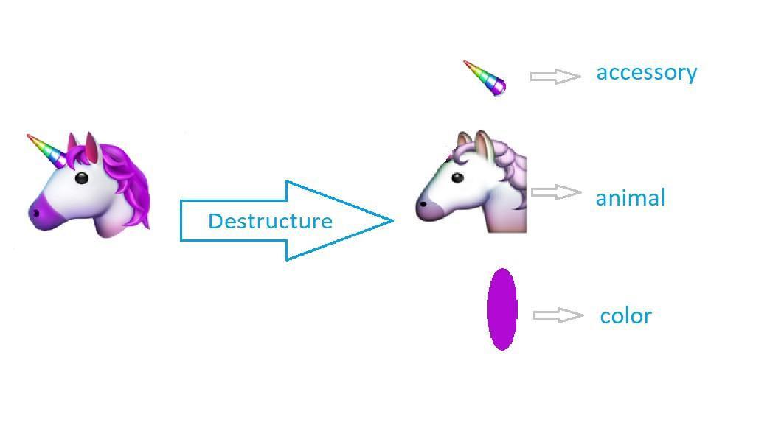
What is destructuring?

Slide 5
Necessity of destructuring
A technique for unpacking objects, arrays, and assigning them to variables
Helps to deal with functions that have a lot of parameters, default values
Is convenient to write, easy to maintain and friendly to read
Saves from writing repetitive code
ref: tmedium.com/swlh

Slide 6
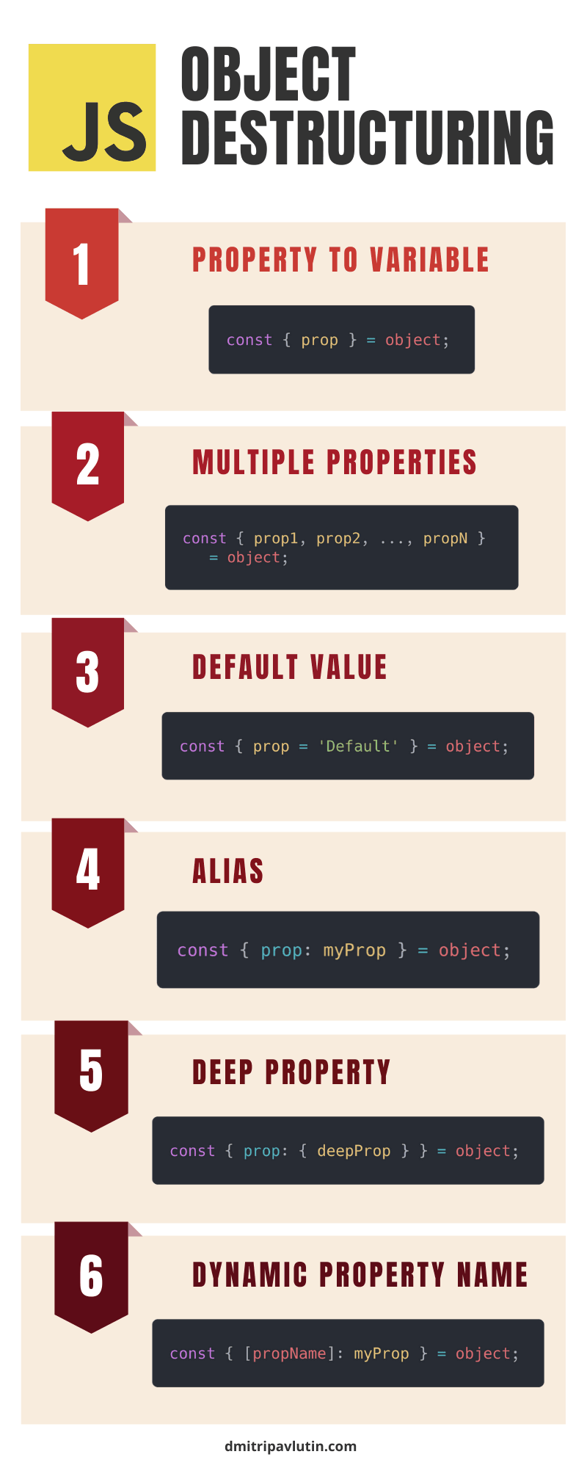

Slide 8

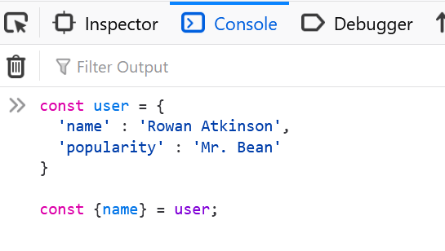
ref: tapasadhikary

Slide 9
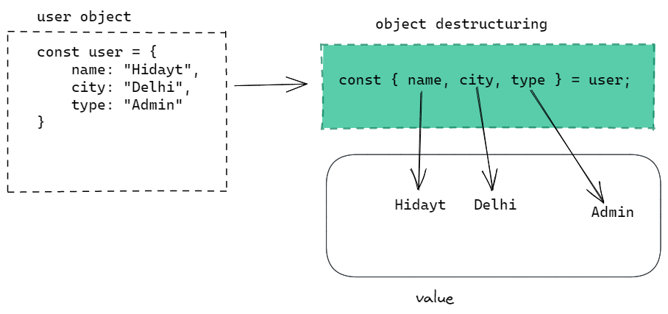

Slide 10
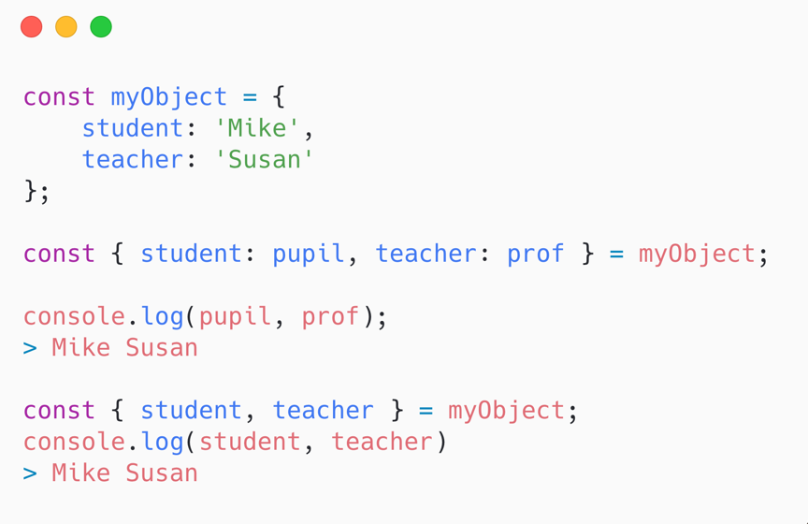

Slide 11
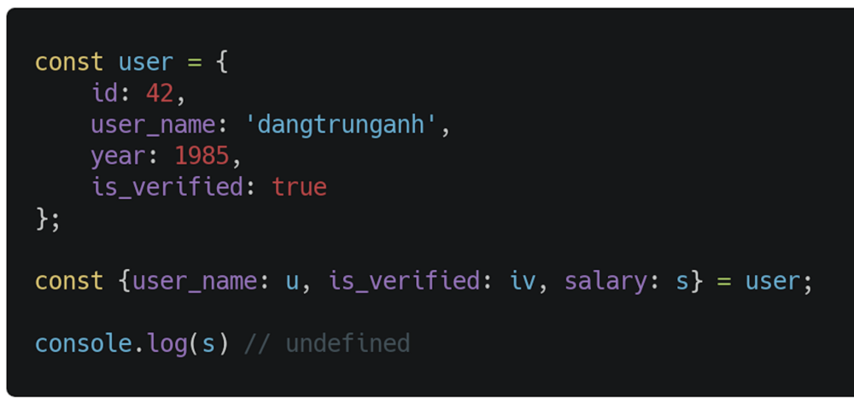

Slide 12
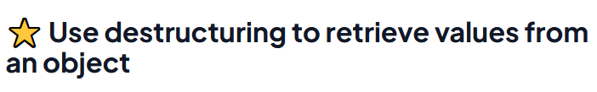
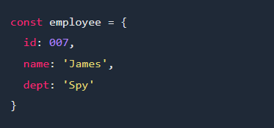
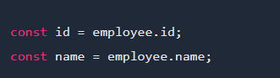
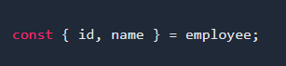
ref: greenroots.info

Slide 13

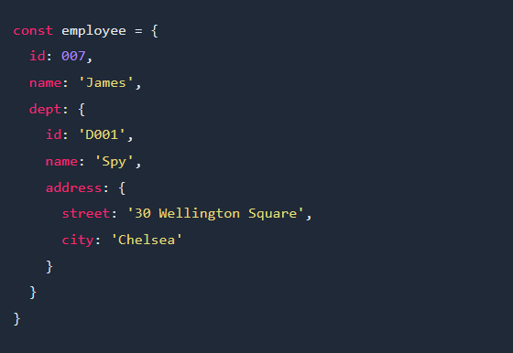
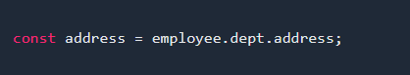
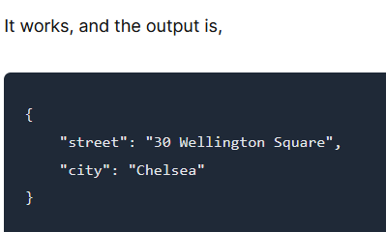
ref: greenroots.info

Slide 14
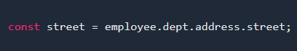
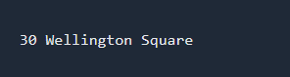
ref: greenroots.info

Slide 15
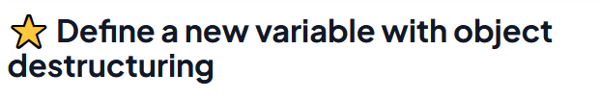
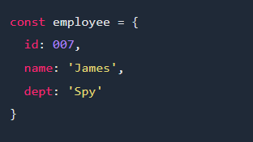
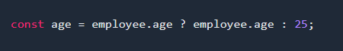
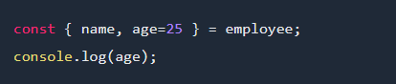
ref: greenroots.info

Slide 16
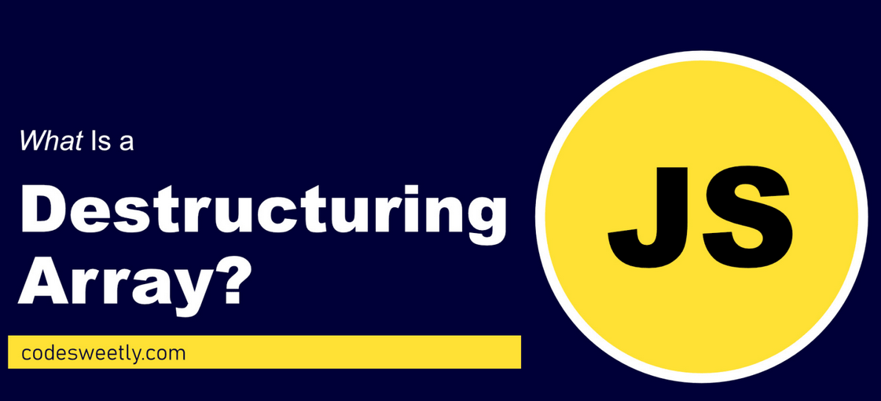

Slide 17
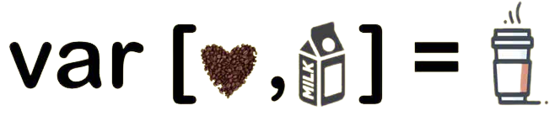

Slide 18
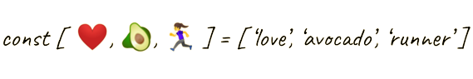

Slide 19
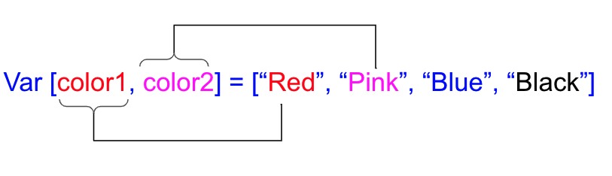

Slide 20
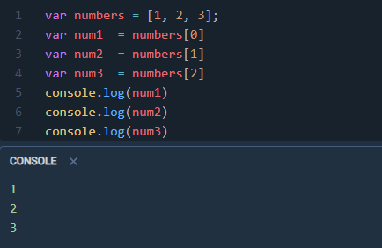
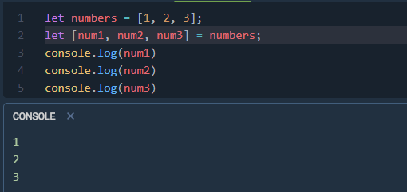
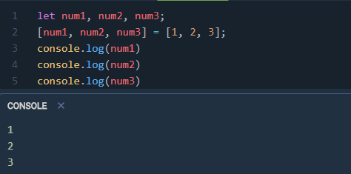
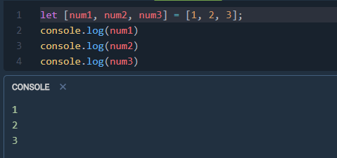
ref: tmedium.com/swlh

Slide 21
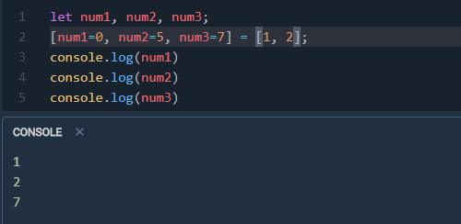
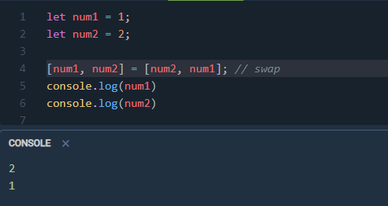
Assign variables with a default value:
Swapping Values:
ref: tmedium.com/swlh

Slide 22
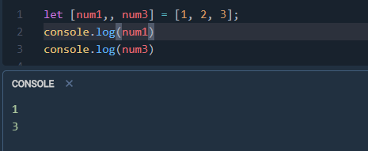
Skipping Items in an Array:
ref: tmedium.com/swlh

Slide 23
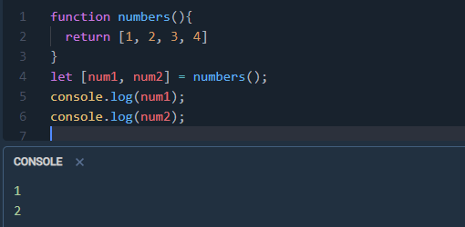
Destructuring with Functions:
ref: tmedium.com/swlh

Slide 24
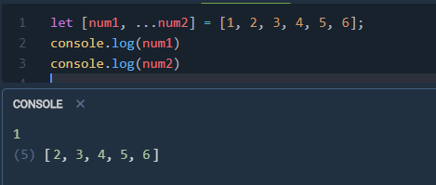
Rest(…) operator:
ref: tmedium.com/swlh

Slide 25
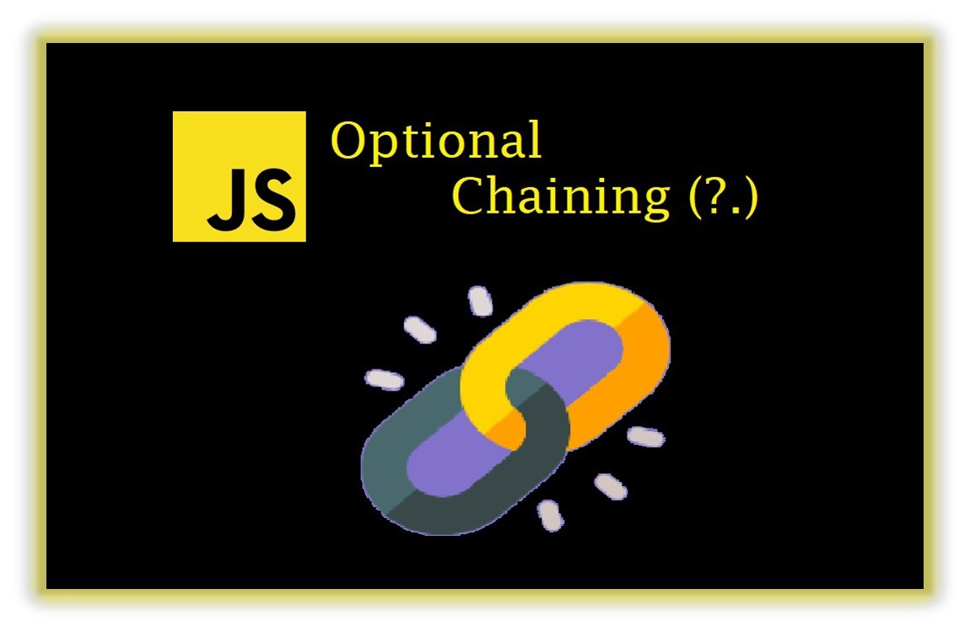

Slide 26
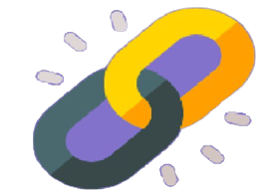
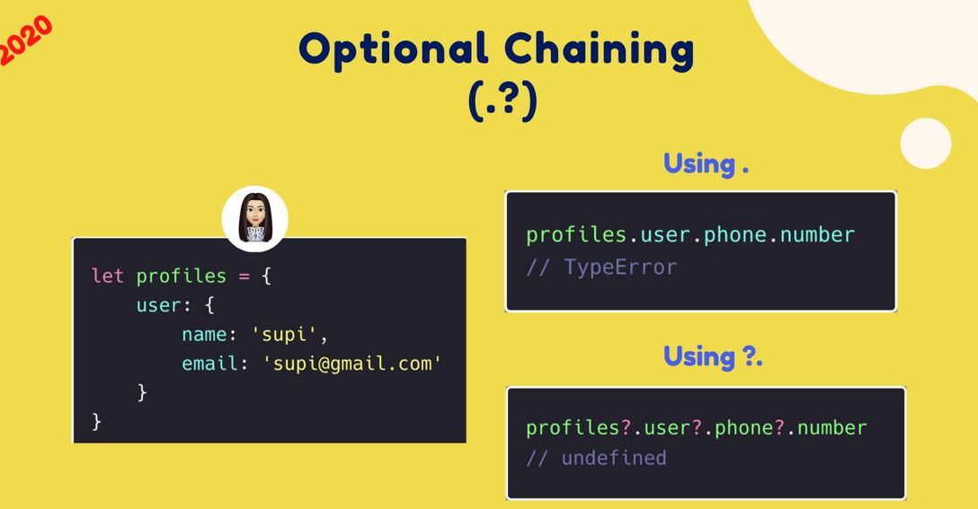

Slide 27
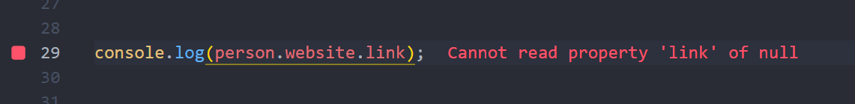
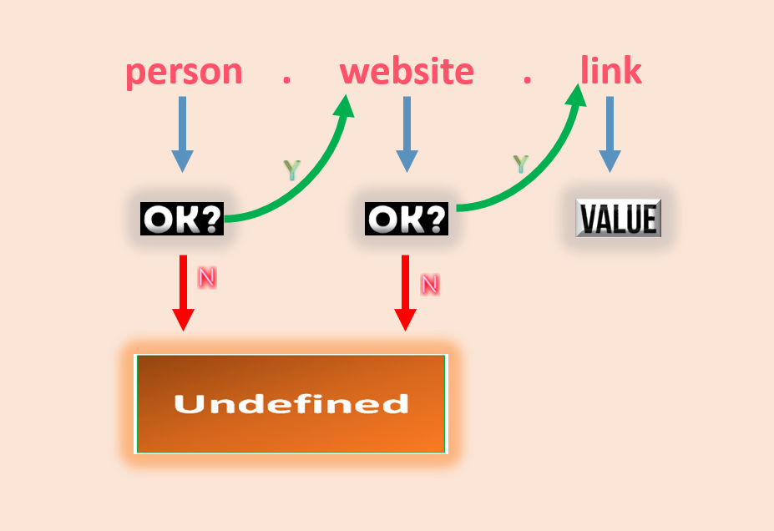
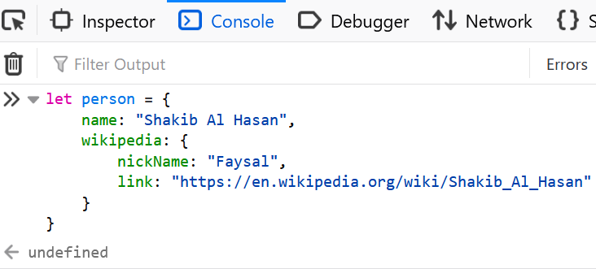

Slide 28
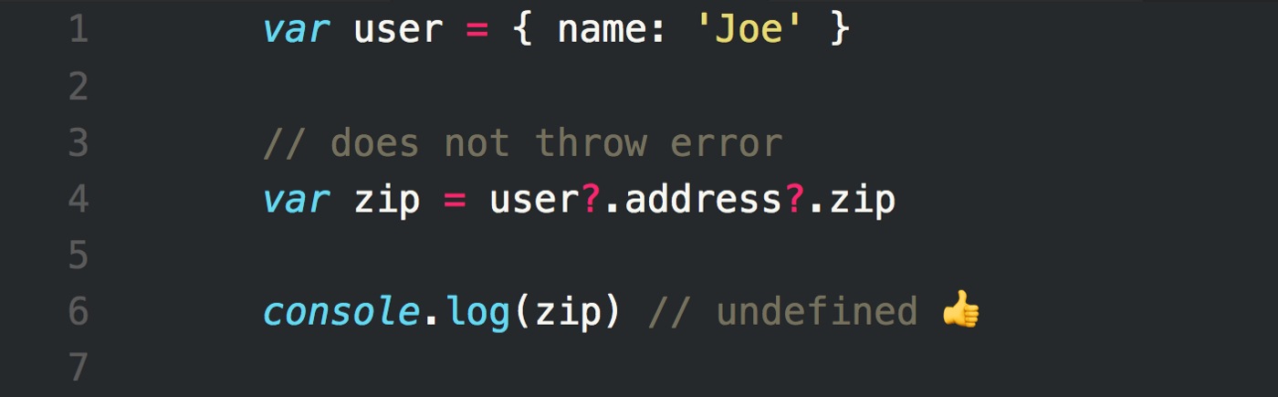

Slide 29
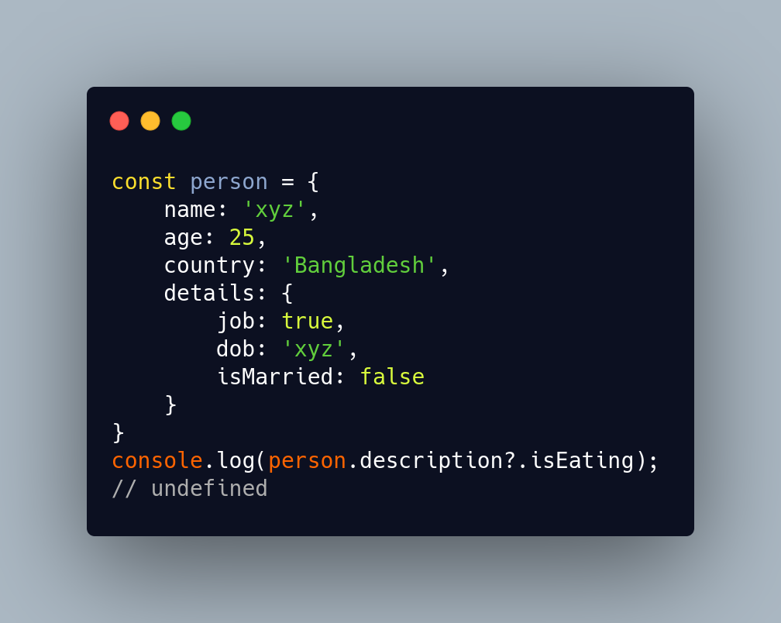

Slide 30
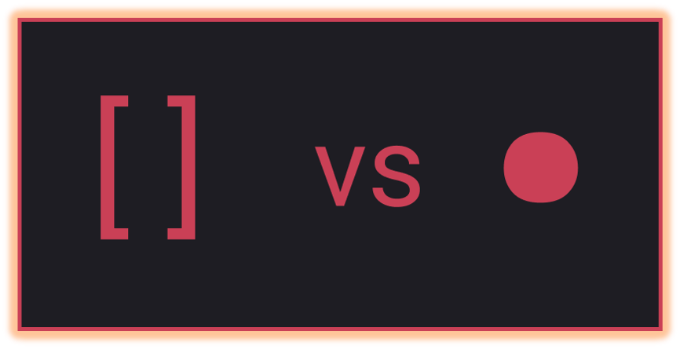
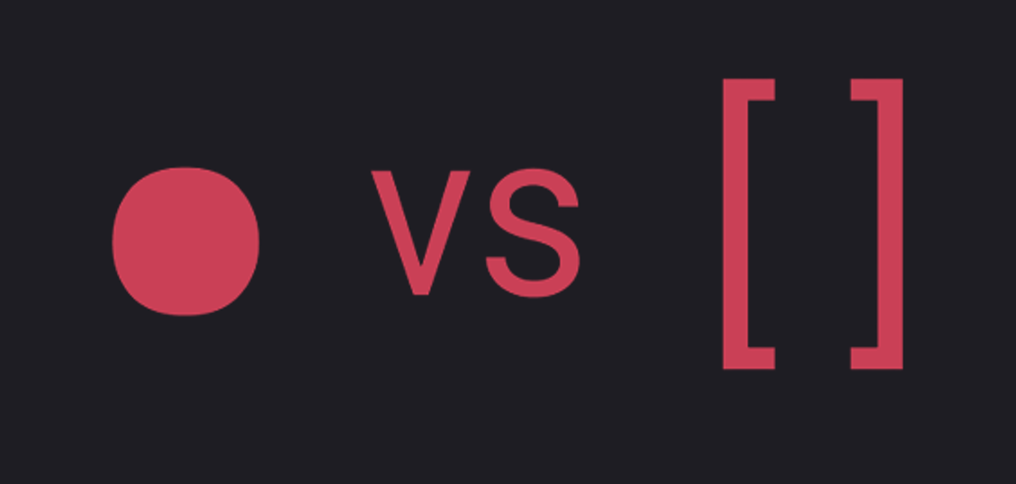
Dot Notation VS Bracket Notation

Slide 31
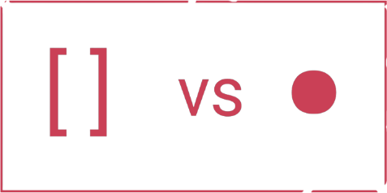

Dot Notation VS Bracket Notation
Dot notation is faster to write and clearer to read, easy to read.
Square bracket notation allows access to properties containing special characters and selection of properties using variables.
You can use variables with bracket notation, but not with dot notation. This is especially useful for situations when you want to access a property but don’t know the name of the property ahead of time.
ref: stackoverflow
ref: javascript.plainenglish.io

Slide 32
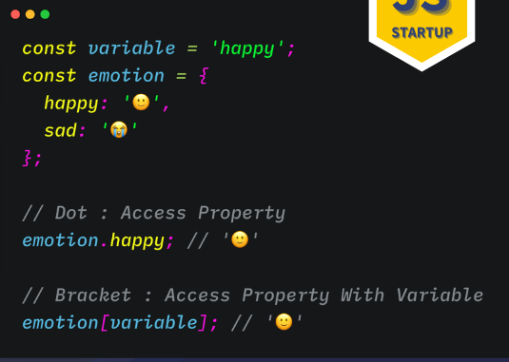

Slide 33
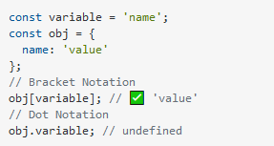
Common mistake you can make while accessing object property:

Slide 34
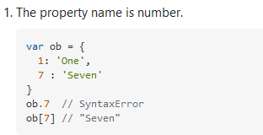
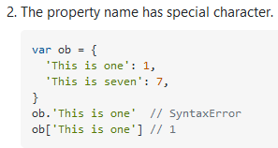
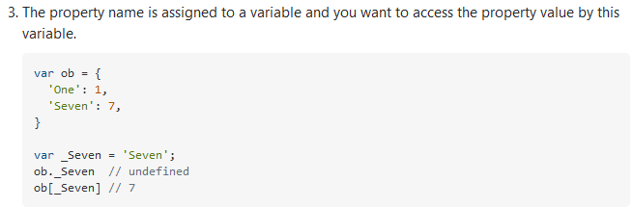
You have to use square bracket notation when-

Slide 35

Cleaner code with dot notation

Slide 36



Dot Notation’s Limitation
Accessing their propriety using dot notation:
But none of this is a problem for the Bracket Notation:

Slide 37


